Slide 1
Take the ball pass the ball
Group Members:
Saad Yousaf.
Burhan Mohyuddin.
Muhammad Hamza Zahid.
Hamza Mirza.

Slide 2
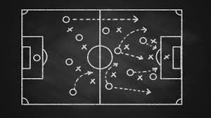
Introduction
We are going to make a network based on passes of a football team.

Slide 3
Data Gathering Techniques
We gather data by watching football matches.

Slide 4
Data Gathering Techniques
In second match we gave weightage to the attacking passes more than the holding passes.

Slide 5
Data Gathering Techniques
We viewed all goals of Barcelona against Real Madrid in recent two years.

Slide 6
Goal
Analyze playing style of a team.
We analyze how a team reacts to its opponent tactics.

Slide 7
Goal
Identify pivotal players in holding the ball.
Identify pivotal players in making attack.

Slide 8
Goal
Identify the combination of player that create most goals.

Slide 9
Techniques
Degree.
Betweenness Centrality.

Slide 10
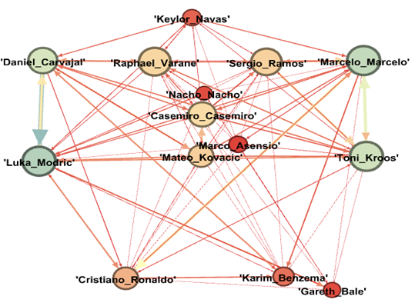
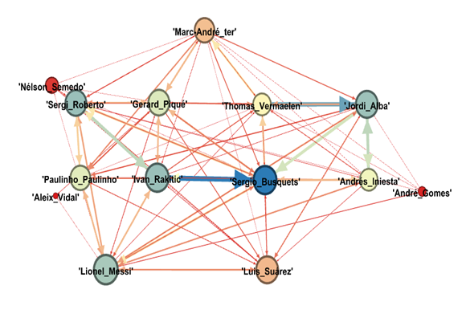
Analysis

Slide 11
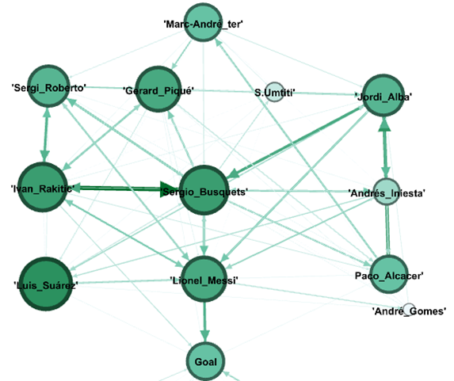
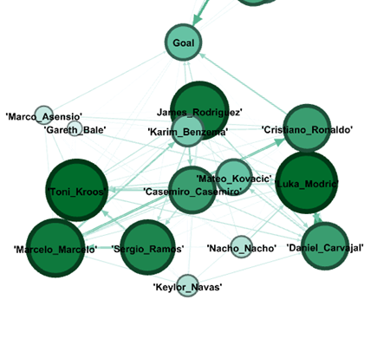
Analysis

Slide 12
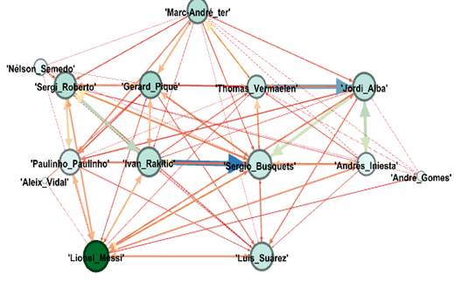
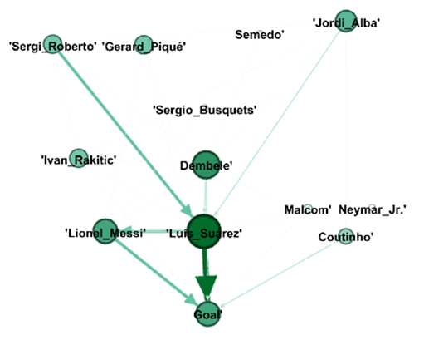
Analysis

Slide 13
Conclusion
Is high possession and too much passes worth it?

